Slide 1


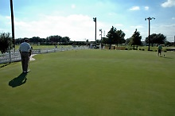
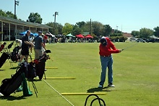
引领 - 利博蒂高尔夫学校
LtoL - Liberty Golf School
我们拥有年轻高尔夫球学员发展所需的所有装备和资源。
We have access to every form of training necessary for the development of young golfers.
在专业指导区有12个真草开球台，开球区内有70个真草开球台，同时中心拥有30个加热开球台以应对雨水天气，此外还有两个室内击打练习区。
There are 12 grass stalls in the dedicated instructional area. Expansive range tee line with 70 grass stalls. For inclement weather we have 15 covered and heated stalls, and an additional 15 uncovered when the grass is too wet to practice on.We also have two indoor hitting bays.
在短杆练习区有南北40码长的球道果岭区域，东侧有两个沙土障碍区和一个草地障碍区，西侧有起伏的山坡练习区。
Short game area with forty yards of fairway north and south of the green with 5 target flags. Two sand bunkers and a grass bunker on the east side, and rolling hills with rough on the west side.

Slide 2
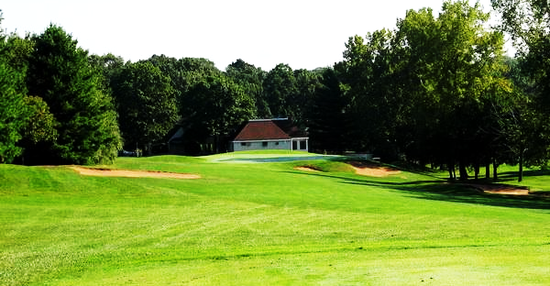
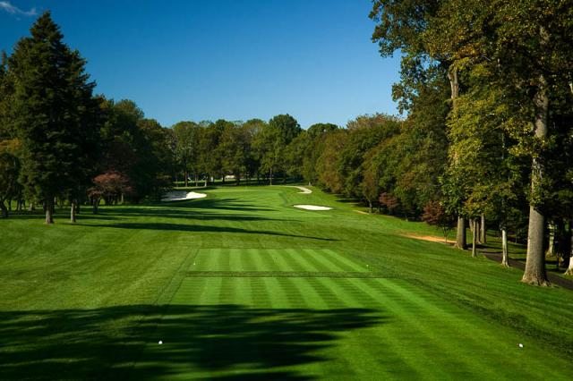
引领 - 利博蒂高尔夫学校
LtoL - Liberty Golf School
两个百慕大冠军果岭是拥有15，000平方公尺的推杆练习区，同时也可用于练习切杆与短距离劈起杆。
Two Champion Bermuda Greens giving us over 15,000 square feet of putting surface which we will also use for chipping and short pitching practice.
东边尽头设有一个球道障碍练习区，西边尽头设有一个全挥杆练习区。
Two Champion Bermuda Greens giving us over 15,000 square feet of putting surface which we will also use for chipping and short pitching practice.
中心拥有完善的设施维修保养能力，而且所有的维修、调整、更新费用不会包含在指导费用里。
A fairway bunker on the east end of our tee line, and an uneven lies area for full swing on the west end.

Slide 3
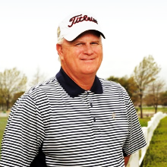
指导总监 - 曼尼斯职业履历
Director of Instruction – Maness’ Career Highlight
参加1988美国职业高尔夫球公开赛，3次全美男子业余公开赛，1次全美青年业余公开赛
Participant 1988 US Open, 3 US Men’s Amateurs, and 1 US Junior Amateur
1988年成为全美职业高尔夫球巡回赛会员
PGA Tour Member 1988
1997至2002担任Nicklaus/Flick高尔夫球学校总教练
Lead instructor Nicklaus/Flick Golf Schools 1997-2002
2004年成为北达拉斯职业高尔夫球协会认证教练
Teacher of the year Northern Texas PGA 2004
TPI认证的二级金牌教练
TPI Certified Level 2 Junior
Golf Range杂志评选的前50名高尔夫指导
Top 50 Growth of the Game Instructor, Golf Range Magazine
Mark C Maness

Slide 4
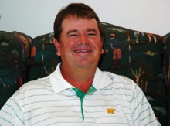

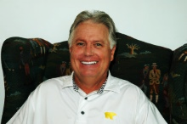
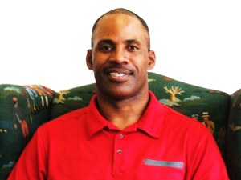
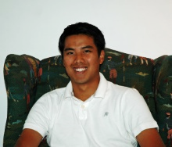
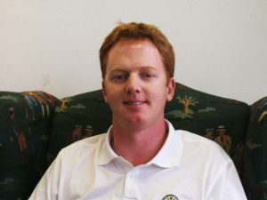
曼尼斯训练团队
Staff in Maness’ Team
总指导 – Head Instructor
Billy Beverley
荣誉指导 – Instructor Emeritus Eldridge Miles
高级指导/总经理 – Instructor/GM
Tom Morehart
初级经理 – Junior Lead Wesley Francis
初级指导 – Junior Instructor
Sutipat Siewsurut
职业教练 – Teaching Professional Richard Noon

Slide 5
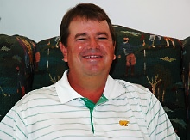
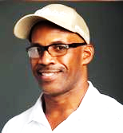
团队精英
Team Elite
全美职业高尔夫球总指导
PGA Head Instructor
拥有丰富的青少年高尔夫训练经验
Possessing great experience in Junior’s Golf training
培养出很多优秀学员进入名校并获得奖学金
Training numerous players attend college on golf scholarships
总指导 Billy Beverley
拥有20年的青少年高尔夫训练经验
Possessing over 20 years of experience as a junior golf instructor
担任Universal Academy（德州排名第四的私立学校）的高尔夫教练
The golf coach at Universal Academy, ranked fourth in the state’s top schools, in Coppell, Texas
曾师从Hank Haney（老虎伍兹的指导）
Has received lessons from Hank Haney（Hank has instructed Tiger Woods)
初级经理 Megan Thothong

Slide 6


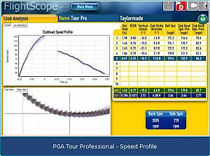
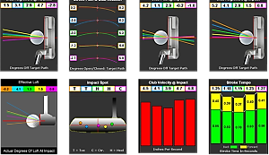
技术支持
Technical support
运用V1视频系统和Casio EX-F1镜头进行高速摄影分析
V1 video systems and the Casio EX-F1 camera for high speed video analysis
运用K-Vest得到训练的身体状态信息反馈
K-Vest for bio feedback training
运用Tomi和SkyPro得到推杆的信息反馈
Tomi, and SkyPro for putting feedback
运用飞行监视器来调整球杆，保证挥杆技术的提升
Flightscope launch monitor for fitting and confirmation of swing improvement
针对不同的个人和小组制定个性化有针对性的训练方案，每个学生每周会有2小时的个人辅导。
A program will be built for each individual and group instruction will be structured in a way as to cater to the individual needs. Each student will receive 2 hours per week of individual instruction

Slide 7
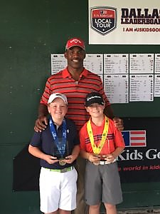
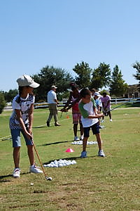
比赛与训练计划
Competition and training program
让学生参与到真正的比赛中，这对学生的高尔夫球发展至关重要。通过比赛中对学生的观察，可以更好的完善学生的训练与指导计划。
We will have players engage in competition on a regular basis. This is crucial to the player’s development. Through our observation of tournament play we will be able to better structure each child’s practice and instruction.
根据学生的水平计划为学生提供每个月2-4次的个人比赛机会。
we hope to have them compete in 2-4 tournaments per month depending on their skill level.
每周至少提供1-2次的训练（包括比赛），训练费用包含在项目费用内，个人比赛会收取额外费用，每名学生的比赛预估费用会在评估学生水平以及确定比赛的日程后确定。
We will play a minimum1-2 times per week, including tournament play.The fees for regular play are included in the program fee. Individual Tournament fees will be an additional expense, an estimate per child will be available after assessment of skills and determination of tournament schedule.

Slide 8
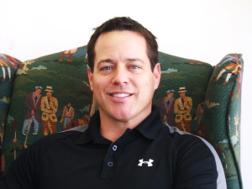
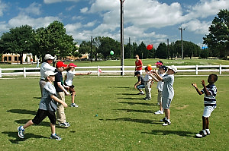
运动健身与营养计划
Exercise Fitness and Nutrition Program
Chris Ownbey在2002年加入曼尼斯的团队，2004年，他帮助曼尼斯发起了TPI青少年高尔夫培养计划。Ownbey将会全权负责学生的运动健身与营养计划，使他们成为优秀的高尔夫球手。
Chris Ownbey joined our staff in 2002 。He helped us initiate our TPI (Titleist Performance Institute) Junior program in 2004. He will work directly with the youth in maximizing their athleticism and training them in nutrition for high performance athletes.
项目的大部分运动健身活动将会在室外，只有在少年急速增长期后6-12个月的孩子才会接受力量训练，直到孩子到达青春期后才会接受大力量的训练。为了孩子的运动成长，中心会科学合理的进行小重量的标准动作训练。
Most of what we will do will be outdoors as weight training will only be done with kids who are six to twelve months past their growth spurt. Until kids reach puberty they shouldn’t engage in heavy weight lifting. We will teach proper form with light weights and use activity based training for athletic development.
Chris Ownbey

Slide 9


运动健身与营养计划
Exercise Fitness and Nutrition Program
饮食营养结构对孩子非常重要，为了让孩子有更好的训练状态，我们会培养孩子养成良好的饮食习惯。
It’s very important that they learn how to eat, what to eat, and when to eat to maximize performance on the course, when training, and in practice.
作为项目的一部分，在训练中我们会提供运动饮料和能量补充剂
As part of training we will provide snacks and drinks during practice time at facility and on course.

Slide 10
美国引领 - 利博蒂高尔夫夏令营
LtoL - Liberty Golf Summer Camp
夏令营特色：
Summer Camp Features:
资深的教练、专业的训练场地，使得每个学员都能获得正规的指导及练习。
Experienced coaches, professional training ground, so that each student can get formal guidance and practice
模拟实战比赛，无论学员是初次接触此项运动还是对高尔夫已有一定了解，都能够在严格的操练过程中对标准动作有深刻的领悟
Simulated live game, regardless of whether the students are first contact with the sport or golf has a certain understanding, can be in the strict exercise process on the standard action has a profound understanding
学习ESL英语课程，掌握高尔夫实用专业术语
Learn ESL English courses and master practical technical terms for golf
训练之余，深度走访美国中部及东部的六所城市以及顶级高校（哈佛、麻省理工），感受美国最繁华的城市魅力以及高等院校校园氛围，为未来埋下梦想的种子
In addition to training, visit six cities in the central and eastern United States, as well as top universities (Harvard, MIT), and experience the charm of America's busiest cities and the atmosphere of college campuses, so that the seeds of a dream for the future
入住达拉斯的寄宿家庭，接触美国本土生活，融入美语环境，储备海外独立生活能力
Stay with a host family in Dallas, get in touch with the Native American life, integrate into the American language environment, and reserve the ability to live independently overseas

Slide 11



夏令营日程安排
Summer Camp Schedule
夏令营的前半部分学生会在达拉斯进行高尔夫球训练以及ESL英语及文化教学。其中还会设有参观和交流的活动，如参观美国牛仔文化重镇Fort Worth，参观达拉斯市政厅并与达拉斯市长交流互动等。
The first half of the camp will be in Dallas for golf training and ESL English and culture teaching. There will also be visits and exchanges, such as a visit to Fort Worth, a major American cowboy culture town, a visit to Dallas City Hall and an interaction with the mayor of Dallas.
夏令营的后半部分是美国东北部六日游，沿途会游览纽约、费城、华盛顿、尼亚加拉瀑布、波士顿等城市。
The second half of the camp is a six-day tour of the Northeast, with tours of New York, Philadelphia, Washington, Niagara Falls, Boston and other cities along the way.

Slide 12
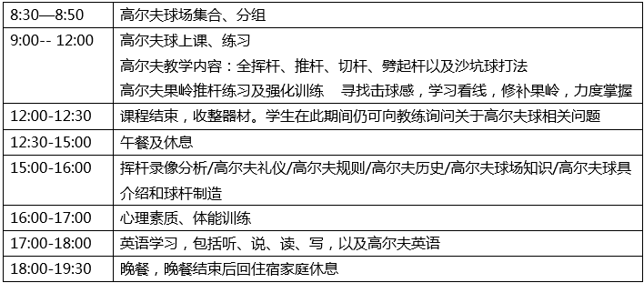
引领每日高尔夫课程安排
注：每周最后一天上午的高尔夫球训练改为9洞高尔夫球实战教学及比赛. 体验高尔夫下场的乐趣。

Slide 13
LtoL the Daily Golf Course Schelduel
8:30 - 8:50 Golf Course Collections, Grouping
9:00 - 12:00 Golf teaching content: Full swing, Putter , Cut rod, Pick up rod and bunker ball play.
Golf green putting practice and intensive practice, looking for hitting, learning to see the
line, repairing the green, mastering
12:00 - 12:30 The course ends and the equipment is finished. Students can still ask the coach about
golf related issues during this time.
12:30 - 15:00 Lunch break
15:00 - 16:00 Swing video analysis, golf etiquette, golf history, golf rules, golf course knowledge, golf
club introduction and club manufacturing
16:00 - 17:00 Psychological quality, physical training
17:00 - 18:00 English learning, including listening, speaking, reading, writing and golf English
Note: Golf training on the last morning of each week is changed to 9-hole golf practice
and tournaments. Experience the fun of golf.

Slide 14
交通、住宿及费用明细
Details of transportation, accommodation and expenses
交通：美国境内交通采用旅游空调巴士
Transportation: Travel-air-conditioned buses for traffic in the U.S.
住宿：学习期间住宿安排在美国寄宿家庭，两人一个房间(或本地Hotel)； 旅游期间住宿安排入住 美国知名连锁酒店
Accommodation: Accommodation during study is arranged for a stay-at-home family in the United States, one
room for two (or a local hotel);
费用：1周旅游、比赛 + 1周高尔夫技能提高训练：4200美金。 家长费用：2800美金
1周旅游、比赛 + 2周高尔夫技能提高训练：6300美金。 家长费用：4200美金
Cost: 1 week tour, tournament and 1 week golf skill improvement training: $4,200/person.
Parental fee: $2,100/person.
1 week tour, tournament and 2 weeks golf skill improvement training: $6,300/per person.
Parental fee: $3,150per person.
费用包含：住宿、餐食安排、所有的教学费用，游览门票以及活动期间平安意外保险费用。
The cost includes: accommodation, meal arrangements, all teaching fees, tour tickets and security
insurance during the event.
费用不包含：机票、参赛费用、项目以外的一对一私教课、个人电话、理发、购物及一切私人性质
费用及日程中没有安排的节目。
Fees are not included: air tickets, entry fees, one-on-one private lessons outside the program,
personal phone calls, haircuts, shopping and all private nature and there are no
programs scheduled for the fee and schedule.

Slide 15
付款方式：
交报名资料时，请一并交付至报名处。（请和国内确定付款方式！谢谢！！）
退款细则：
报名后，如临时取消参加，学生家长须以书面材料通知国际夏令营主办方。主办方不受理家长的口头及电话里的取消通知；
报名后，未经主办单位同意取消报名的学生，报名费一概不退；
若非因学生本人及家庭背景导致签证拒签，所交费用全部退还；
签证签出后，如果取消参加本夏令营，扣总夏令营報名费的50%，所获签证将送交领事馆进行注销；
团队出发前10天，如果取消参加本夏令营，扣总夏令营报名费的70%；
团队出发前4-1天，如果取消参加本夏令营，扣总夏令营报名费的100%；
任何时候如果取消参加本夏令营，除注册费不予退还之外，已经办理的文件、签证、机票以及安排好的国外接待等，将扣除相应费用。
适合对象：
有高尔夫学习经历的或无高尔夫学习经历的在读学生；身体健康，无不适应长途旅行的疾病，有生活自理能力。11岁以下的学员需家长陪同
报名截止日期：
201 年 月日前报名享有优惠。名额有限，请速报名！（注：尚未申请护照的学生报名截止日期为月日）

Slide 16
Payment: When you submit your registration information, please deliver it to the registration office.
(Please determine the payment method within your country!) Thank you!!
Refund details: After registration, if the registration is temporarily cancelled, the parents of the students must
notify the international summer camp organizers in writing.
The sponsor does not accept the parents' verbal ortelephone cancellation notice;
After registration, students who cancel the registration without the consent of the organizer shall not refund
the registration fee;
If the visa is not refused due to the student's own and family background, the fee paid will be refunded in full;
After the visa is checked out, if you cancel your participation in this summer camp, 50% of the total summer
camp name fee will be deducted, and the visa obtained will be sent to the consulate for cancellation;
10 days before the team departure, if you cancel to participate in this summer camp, the total summer camp registration fee of 70%;
4-1 days before the team departure, if you cancel to participate in this summer camp, the total summer camp registration fee of 100%;
Any time you cancel your participation in this summer camp, in addition to the non-refundable registration fee,
the documents, visas, air tickets and arranged foreign receptionwill will be deducted.
Suitable for objects: Students who have golf learning experience or have no golf learning experience; Parents are
required for students under 11 years of age.
Deadline for registration: Sign up for the offer before the month of 201. Limited number of places
Please register quickly!
(Note: The deadline for registration for students who have not yet applied for a passport is the month of the month)

Slide 17
引领 - 利博蒂合作意向
友好互访
体育文化交流团
  中美双方的学生可以在老师的带领下前往对方学校进行冬季或夏季的游学体验，让学生们感受在彼此国家的学习与生活。此项目的时间建议定在每年中美的寒假与暑假期间，参加该项目的人数由双方协定，费用由参加学生及家庭自理。
中美校际高尔夫交流
  鉴于引领-利博蒂在高尔夫项目方面拥有强大的师资力量，美方会向中国学校提供高尔夫相关的师资支持。中美双方可进行校际间的互访、比赛交流。
交换生项目
  如果利博蒂私立学校有交换生名额，在中国学校内可以招募意愿前往卡罗尔顿私立学校进行短期30天至一学期或一学年学习及生活的学生。参加该项目的人数由双方协定，费用由参加学生及家庭自理。
派送留学生
  美方学校每年将从中方学校选拔出体育类的人才赴引领-利博蒂私立学校留学交流并根据学生的学习成果颁发奖学金。美方学校可提供I-20(国际学生录取通知书，中国学生可持I-20到美国大使馆申请F-1留学签证)，留学费用由学生自理。

Slide 18
Leading - Liberty's Intent Cooperation
Friendly visits
Sports Cultural Exchange Students from both sides of the Chinese and American countries can travel to each other's schools under the guidance of their teachers for a winter or summer study experience, allowing them to experience their study and life in each other's countries.
The time of this project is scheduled for each year during the winter and summer vacations between China and the
United States, and the number of participants in the program is agreed by the two parties at the expense of the
students and their families.
Inter-School Golf Exchange between China and the United States Given the strong faculty of the leadership-Liboti in golf programs, the United States will provide golf-related teacher support to Chinese schools.
China and the United States can conduct inter-school visits and competition exchanges.
Exchange student project If there are exchange places at the Liboti private school, students who wish to go to
Carrollton Private School for a short period of 30 days to one semester or one academic year can be recruited in
Chinese schools.
The number of participants in the project is agreed by the parties and the cost is for the students and families to
take care of themselves.
Sending international students Each year, U.S. schools will select sports talents from Chinese schools to lead the liboti
private school study exchangeand and award scholarships based on students' learning achievements.
U.S. schools can provide I-20 (international student admission notice, Chinese students can use I-20 to the U.S.
Embassy to apply for an F-1 student visa), the cost of studying abroad by the students themselves.

